Slide 1
AN ALGORITHM FOR DETECTION AND PREDICTION OF ACUTE MYOCARDIAL INFARCTION USING ECG SIGNAL
Start: 16/11/2015

Slide 2
CONTENT:
WHAT IS ACUTE MYOCARDIAL INFARCTION?
DIAGNOSIS TECHNIQUES FOR AMI
ROLE OF ECG IN AMI
PROPOSED MODEL
ECG FEATURES EXTRACTION
ALGORITHM (MATLAB)
TESTING THE ACCURACY OF THE MODEL
REFERENCES

Slide 3
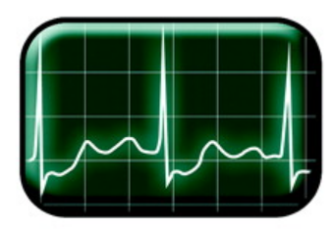
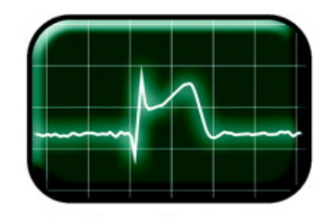
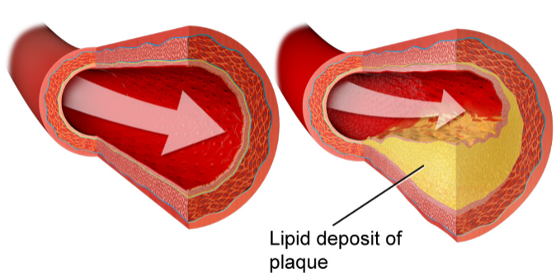
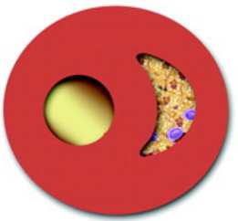
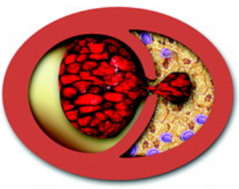
1. WHAT IS ACUTE MYOCARDIAL INFARCTION?
CAD (Coronary Artery Disease)
ST Depression
ST Elevation
Q Pathological
MYOCARDIAL INFARCTION
TISSUE DEATH
ISCHEMIC EVENT

Slide 4


1. WHAT IS ACUTE MYOCARDIAL INFARCTION?
Rate of death:
Vietnam
1980 - now
America:
2005
17.4% - 2000
20% - 2017
1.1 million

Slide 5
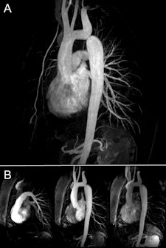
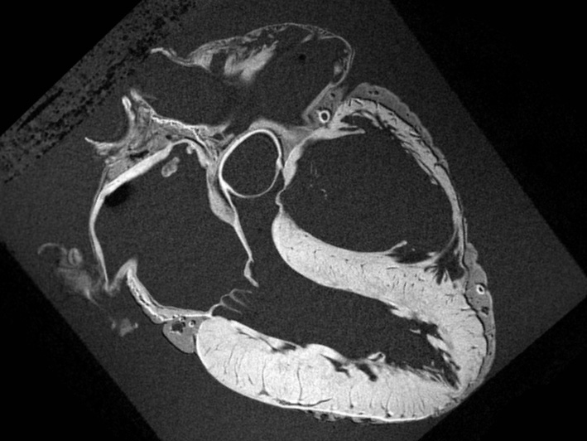
2. DIAGNOSIS TECHNIQUES FOR AMI
Cardiac MRI:

Slide 6
2. DIAGNOSIS TECHNIQUES FOR AMI
A comparison paper between MRI, CTA, Echocardiography and ECG
Cardiac MRI:
Make use of the magnetic characteristic of hydrogen atom => produce image
For detection of AMI:
Look at the image of the heart => structural information
heart beat animation => functional behavior
3D model

Slide 7
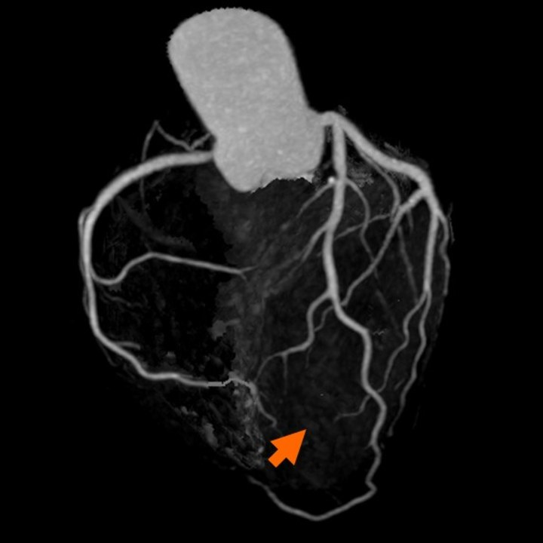
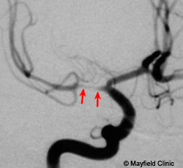
2. DIAGNOSIS TECHNIQUES FOR AMI
CT Angiography:

Slide 8
2. DIAGNOSIS TECHNIQUES FOR AMI
A comparison paper between MRI, CTA, Echocardiography and ECG
CT Angiography:
Using X – rays to highlight blood vessels
For detection of AMI:
Contrast agent is injected to patient’s vein
Preparation
Using X – rays to highlight vessels
Look for obstructed vessels

Slide 9
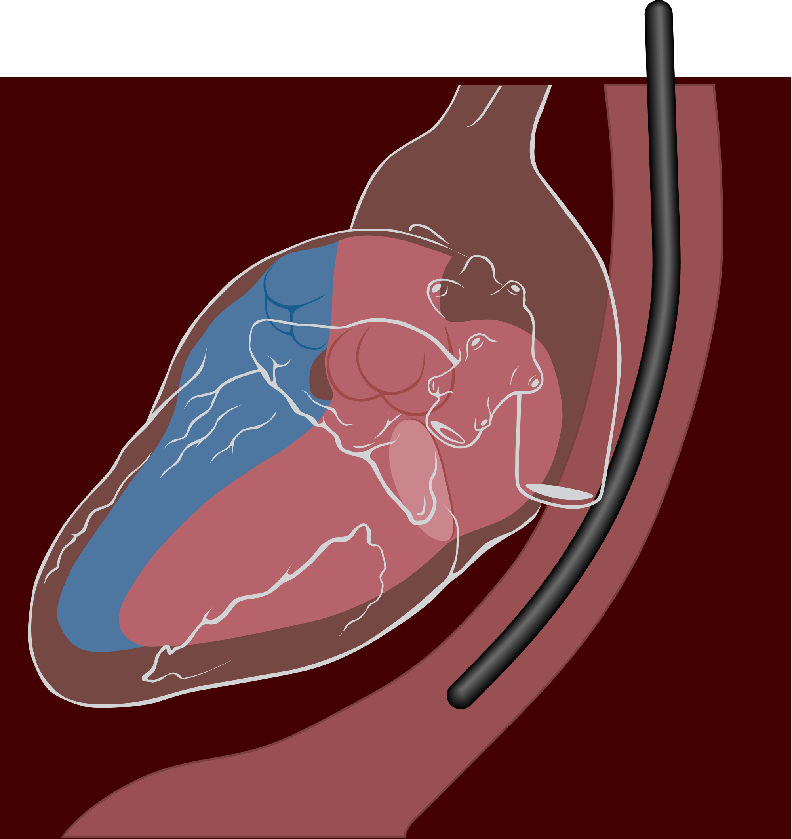
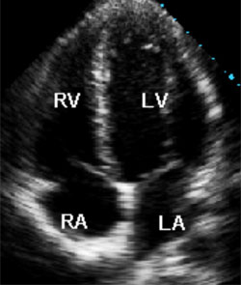
2. DIAGNOSIS TECHNIQUES FOR AMI
Echocardiography: Transesophageal

Slide 10
2. DIAGNOSIS TECHNIQUES FOR AMI
A comparison paper between MRI, CTA, Echocardiography and ECG
Echocardiography:
Using high frequency sound wave to visualize the heart’s structure and function
For detection of AMI:
Look at the grey scale on the image
Look for region that does not contract during each heart beat

Slide 11
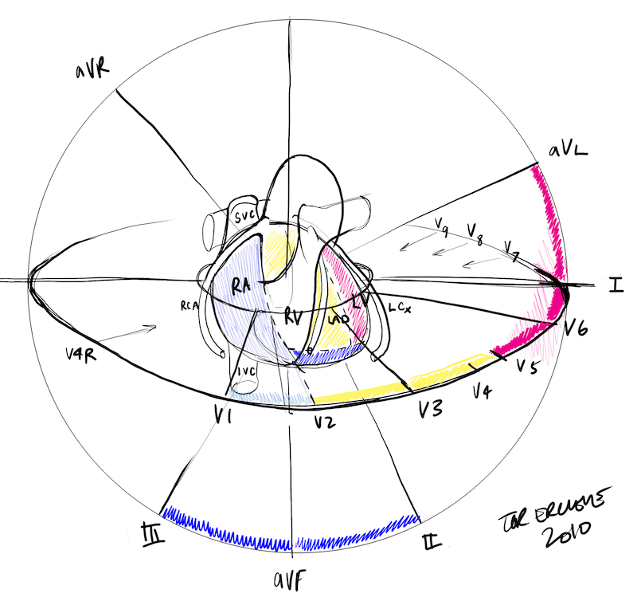
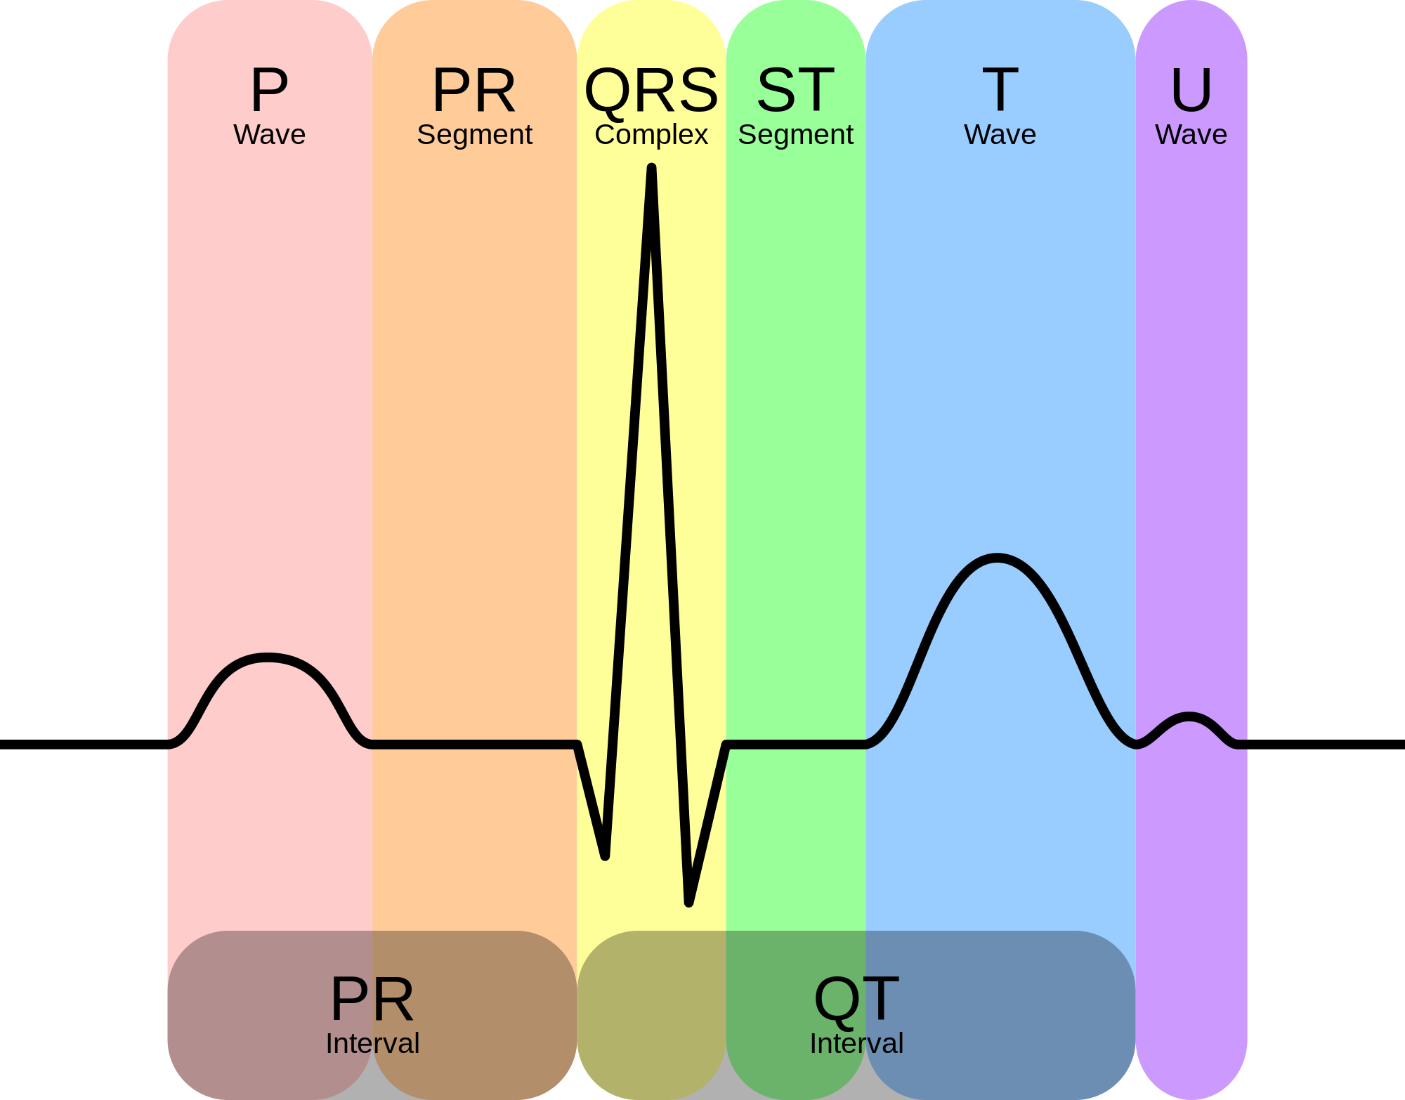
2. DIAGNOSIS TECHNIQUES FOR AMI
The normal ECG:

Slide 12
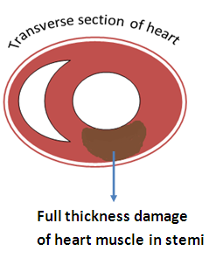
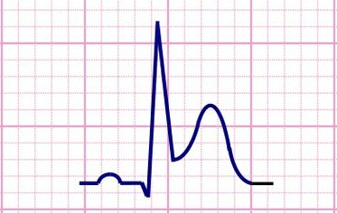
2. DIAGNOSIS TECHNIQUES FOR AMI
The STEMI AMI:
ST Segment Elevation

Slide 13
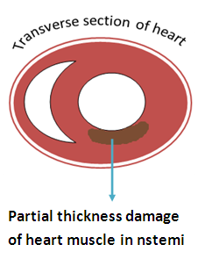
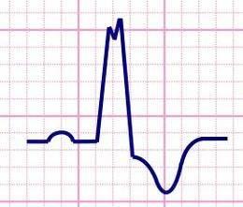
2. DIAGNOSIS TECHNIQUES FOR AMI
The NSTEMI AMI:
ST Segment Depression

Slide 14
2. DIAGNOSIS TECHNIQUES FOR AMI
A comparison paper between MRI, CTA, Echocardiography and ECG
ECG Signal:
Measure the electrical activity of the heart during each heart beats
For detection of AMI:
Look for abnormal ECG patterns => Derive information

Slide 15
2. DIAGNOSIS TECHNIQUES FOR AMI
Summary: A comparison paper between MRI, CTA, Echocardiography and ECG
 | Cardiac MRI | CT Angiography | Echocardiography | ECG
Strength | Clear image Animation 3D model High accuracy | Clear image High accuracy | Good image Animation Suitable for examine the inner structure of the heart | Cheap Fast Information derived is reliable
Weakness | Time consuming Expensive Noise | Time consuming Expensive Radiation risk Allergy | Equipment is cumbersome and not always accessible | Requires strong medical skills to read ECG data

Slide 16
2. DIAGNOSIS TECHNIQUES FOR AMI
CONCLUSION:
ECG is still a standard procedure for patient admission of AMI because it is:
Cheap, device is easily found
Fast => suitable for Emergency Respond
Accurate: proved by several scientific articles
HOWEVER, some DRAWBACKS are:
Require strong interpretation skills with minimal errors
Faster at the interpretation

Slide 17
3. ROLE OF ECG IN AMI: DETECTION
UP
STEMI
ST CHANGES
UP
NSTEMI
DOWN
INVERSE LEAD
DOWN
ECG INPUT
UA, ISCHEMIC
WAVES ABSENCE
NONE
Q WAVE
T INVERTED
NORMAL
NO
WAVES ABSENCE
NO
ST CHANGES
NO
T INVERTED
Q WAVE
NECROSIS

Slide 18
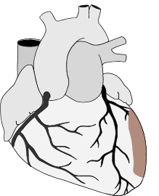
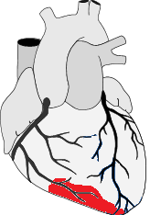
3. ROLE OF ECG IN AMI: LOCALIZATION
Septal
Anterior
Inferior
Posterior
Lateral

Slide 19
3. ROLE OF ECG IN AMI: LOCALIZATION
Septal
ST Elevation in leads:
V1
V2

Slide 20
3. ROLE OF ECG IN AMI: LOCALIZATION
Anterior
ST Elevation in leads:
V3
V4

Slide 21
3. ROLE OF ECG IN AMI: LOCALIZATION
Lateral
ST Elevation in leads:
V5
V6

Slide 22
3. ROLE OF ECG IN AMI: LOCALIZATION
Inferior
ST Elevation in leads:
II
III
aVF

Slide 23
3. ROLE OF ECG IN AMI: LOCALIZATION
Posterior
ST Elevation in leads:
aVR
V7 to V9
ST Depression in leads:
V1
V2

Slide 24
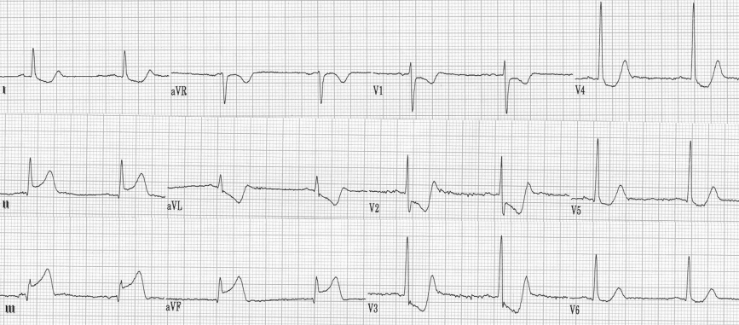
3. ROLE OF ECG IN AMI: AN EXAMPLE

Slide 25
4. PROPOSED MODEL
Prediction
Detection
ECG input

Slide 26

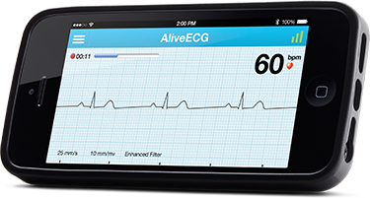
4. PROPOSED MODEL
ECG input

Slide 27
4. PROPOSED MODEL
Read ECG leads
Evaluate abnormalities
Presence, location of AMI
Detection

Slide 28
4. PROPOSED MODEL
Read ECG leads
Compare with Data Training
Forecast the progress of AMI
Prediction

Slide 29
4. PROPOSED MODEL
MODEL BENEFITS:
Real – time monitoring of AMI for patient with high risk of AMI or with previous AMI
Monitoring patient during hospitalization
Help doctors detect AMI faster with less personal errors
Tell the progress of AMI

Slide 30
5. ECG FEATURES EXTRACTION
ECG features need to extract are:
P wave magnitude, position
Q wave magnitude
ST segment slope
T wave direction and magnitude
Leads of interest:
II, III
AVR, AVL, AVF
V1 to V6
Additional leads: V4R, V5R, V6R, V7, V8, V9

Slide 31
5. ECG FEATURES EXTRACTION
Databases used to train the model:
Database with known medical diagnostic value
MGH/MF wave form database from PHYSIONET
Database with long (24 to 48h) measurement of ECG in patients admitted to hospital with acute chest pain
Not yet found

Slide 32
6. DETECTION ALGORITM (MATLAB)
Model used: FUZZY MODEL
Range of values:
ST slope:
Extremely Depressed:
Depressed:
Normal: >= - 0.32mV in lead II
Elevated:
Extremely Elevated:

Slide 33
6. DETECTION ALGORITM (MATLAB)
Model used: FUZZY MODEL
Range of values:
Q wave:
Pathological:
Normal: >= - 0.32mV in lead II
J point magnitude:
Inverted:
Absence:
Normal: >= - 0,15mV in lead II
Peaked:

Slide 34
6. DETECTION ALGORITM (MATLAB)
Model used: FUZZY MODEL
Range of values:
P wave magnitude:
Inverted:
Absence:
Normal: 0.1mV <= P <= 0.3mV
Peaked:
T wave magnitude:
Inverted:
Absence:
Normal: 0.2mV <= P <= 0.3mV
Peaked:

Slide 35
6. DETECTION ALGORITM (MATLAB)
Rules:
 | P wave | Q wave | ST Slope | T wave | Result
IF | Normal | Normal | Normal | Normal | Normal ECG
IF | Absence | Normal | Normal | Normal | UA
IF | Normal | Normal | Normal | Peaked | Stage I AMI
IF | Normal | Normal | Elevated | Peaked | Stage II AMI: STEMI
IF | Normal | Pathological | Elevated | Peaked | Stage III AMI
IF | Normal | Normal or Pathological | Elevated | Inverted | Stage IV AMI
IF | Normal | Normal or Pathological | Normal | Inverted | Stage V AMI
IF | Normal | Pathological | Normal | Normal | Stage VI AMI: tissue necrosis
IF | Normal | Normal or Pathological | Depressed | Normal or inverted | Type 2 AMI: NSTEMI

Slide 36
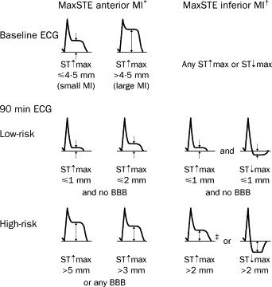
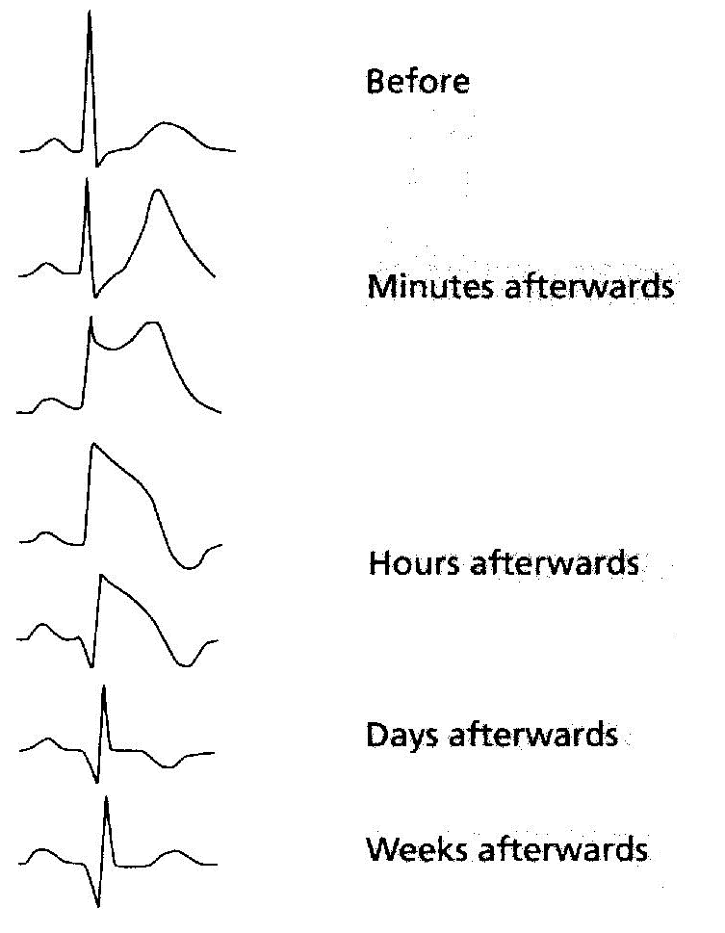
6. PREDICTION ALGORITM (MATLAB)
Basing on general knowledge

Slide 37
6. PREDICTION ALGORITM (MATLAB)
Technique used:
Patient with acute chest pain are admitted to the study
ECG signal is recorded during 24 – 48h
Look at the changing phase on ECG of patient who eventually develop AMI
Find the common pattern
Make conclusion together with marked time
Data about these events are stored as reference
When applied ECG show this pattern, display the time

Slide 38
7. TESTING THE MODEL
Using PHYSIONET data:
Use other databases to test the accuracy of the detection and prediction
Testing with real patient:
Ask for hospital permission to perform detection

Slide 39
8. REFERENCES
[1] Ge Dingfei, Sun Lihui, Wen Xiaojun. Discrimination of Myocardial Infraction Using Orthogonal ECG and Fuzzy Weighted Method
[2] Li Sun, Yanping Lu. ECG Analysis Using Multiple Instance Learning for Myocardial Infarction Detection
[3] H SadAbadi, A Jalali, M Ghasemi, P Ghorbanian, M Atarod, H Golbayani, A Ghaffari. Variation of ECG Features on Torso Plane: An Innovative Approach to Myocardial Infarction Detection
[4] D. Dubois and H. Prade. Fuzzy Sets and Systems. Academic Press, New York
[5] Nock, R. and Nielsen, "On Weighting Clustering", IEEE Trans. on Pattern Analysis and Machine Intelligence

Slide 40
THANK YOU

Slide 41
APPLICATION MODEL AND DATA SELECTED FOR RESEARCH
Therefore, we develop an application to help doctors interpret the ECG signals for AMI
Why an application?
Faster interpretation
Less errors
What is more of it? AN WEB – APPLICATION, WHY?
All people can have access to this app
Data transferred, stored and managed
Can potentially connect patients with doctor

Slide 42




APPLICATION MODEL
APP MODEL:
PATIENTS
WEB - APP
MANAGEMENT
SYSTEM
DOCTOR
CLOUD
SERVER
ECG DEVICE
SEND DATA

Slide 43
RISK FACTORS
Some specific conditions that provide additional but beneficial for calculating the severity and predict the improvement of AMI
Several risk factor, but the most important are:
1. Age + BP => strong indicator after 50
2. Chest pain (scale, position, duration)
3. History of diabetes, obesity (blood glucose)
4. History of smoking, alcohol
5. Woman/Man
6. Previous heart attack
Each risk factors is associated with a weighting coefficient

Slide 44
6. ALGORITHM WITH RISK FACTORS INCLUDED
ECG signal
ST changes
STEMI
Leads
Location
N
Y
Y
Wave absence?
ST Elevation?
Magn
Severity
N
Y
Risk factors?
N
Heart failure
STDMI
Leads
Location
N
Y
Normal
Probability
Medical attention
Obese
Hyper
T peak - inver
Progress

Slide 45
THE END

